Slide 1

SCOPE OF VARIABLE IN VB.NET
The scope of a declared element or variable is the set of all code that can refer to it without explicit qualification.
In other words, an element or variable scope is its accessibility in your code.
An element can have scope at one of the following levels:-
BLOCK SCOPE
PROCEDURE SCOPE
MODULE SCOPE
NAMESPACE SCOPE

Slide 2
BLOCK SCOPE
A block is a set of statements enclosed within initiating and terminating declaration statements, such as the following:
Do ….. Loop
If …..End If
For ….. Next, For Each … next
Select ….. End Select
Try ….. End Try
While …… End While
For Example:-
If n < 1291 Then
Dim cube As Integer
Cube = n ^ 3
End If
Here cube variable can not be accessed by the code outside if …End If.

Slide 3
PROCEDURE SCOPE
An element/variable declared within a procedure is not available outside that procedure.
Only the procedure that contains the declaration can use it.
Variables at this level are also known as local variables
Private Sub button_click()
Dim a As Integer
MsgBox(a)/MeesageBox.Show(a)
End Sub

Slide 4
MODULE SCOPE
An element or variable is available to all code within the module in which it is declared.
Module level scope can be define with:
  Class …… End Class
  Structure ….. End Structure
We can declare elements at this level by placing the declaration statement outside of any procedure or block but within the module, class, or structure.

Slide 5
NAMESPACE SCOPE
If we declare an element at module level using the Friend (Visual Basic) or Public (Visual Basic) keyword, it becomes available to all procedures throughout the namespace in which the element is declared.
Namespace scope includes nested namespaces. An element available from within a namespace is also available from within any namespace nested inside that namespace.

Slide 6
VARIABLE LIFETIME
In addition to their scope, variables also have a lifetime, which indicates variable existence during program execution.
Scope, on the other hand, indicates whether the variables that exist are accessible or not.
The difference is most clear in variables with block-level scope: although they are visible only within the block construct within which they are declared, their lifetime is the lifetime of the procedure in which they are declared.
Similarly, the lifetime of variables with procedure scope terminates when a procedure ends, but they are visible only when the procedure is actually executing, not when the procedure has in turn called other procedures.

Slide 7
STATIC VARIABLES
A static variable is a variable whose lifetime extends across the entire run of the program.
Static variable must be initialized while declaring it.
The static keyword in VB.Net allows a variable to maintain the variables value between method or procedure calls.
Ordinarily, the lifetime of variables with procedure scope terminates when the procedure ends. However, we can declare variables to be static, in which case their lifetime is the duration of the application, even though they have procedure scope.
For example, the following code shows a simple Windows application that tracks the number of times its single interface object, a command button, is clicked:

Slide 8
Example:-
Public Class Form1
Private Sub cmdClickCtr_Click(ByVal sender As System.Object, _
ByVal e As System.EventArgs) Handles cmdClickCtr.Click
Static ctr As Integer = 1
MsgBox("Button was clicked " & ctr & " times.")
ctr += 1
End Sub
End Class

Slide 9
Ordinarily, the lifetime of the counter variable, ctr, is limited to the duration that the Click event procedure runs.
Declaring it as static, however, causes it to exist throughout the lifetime of the application.
Hence, it can track the total number of times the button is clicked since the application started.
Note that the Static variable declaration, which also initializes the variable ctr to a value of 1, is executed only once. We do not need to be concerned that the value of ctr will be reset to 1 each time the event procedure executes.

Slide 10
BASIC OPERATORS IN VB.NET
Visual Basic comes with many built-in operators that allow us to manipulate data.
An operator performs a function on one or more operands.
Following are the List of operators:-
  Arithmetic Operators
  Concatenation Operators
  Comparison Operators
  Logical / Bitwise Operators
  Assignment Operator

Slide 11
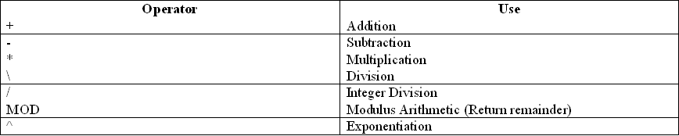
ARITHMETIC OPERATORS

Slide 12
CONCATENATION OPERATORS
Note:- When concatenating a string variable with a numeric value then don’t use + operator otherwise it will give an error.
Operator | Use
+ | String Concatenation
& | String Concatenation

Slide 13
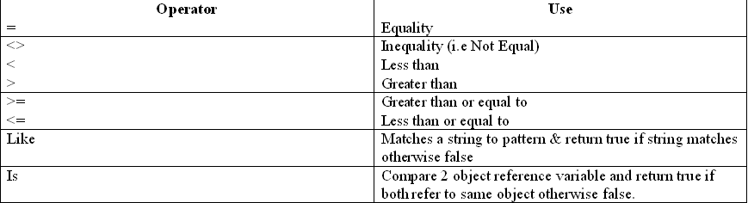
COMPARISON OPERATORS
A comparison operator compares operands and returns a logical value based on whether the comparison is true or not. The table below summarizes them:

Slide 14
LIKE OPERATOR
Like operator matches a string to pattern and return true if string matches a pattern otherwise return false.
Syntax:
Result= String Like Pattern
Note- Result will be of Boolean Type.
Ex- Dim Result as Boolean
Result=”Hello” Like “He*”
MsgBox(Result) ‘Return True
Pattern matching feature allow to match string using Wildcard Characters, Character-list or character ranges, in any combinations.

Slide 15
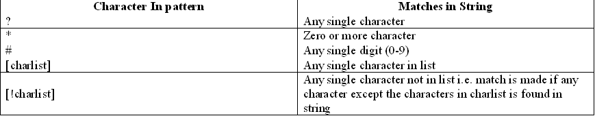
Example:-
MsgBox (“Bat” Like “B?t”) O/P-True
MsgBox(“John” Like “Jo*”) O/P- True
MsgBox(“401” Like “#01”) O/P- True
MsgBox(“Bat” Like B[a-f]t) O/P - True
MsgBox(“Bit” Like B[a-f]t) O/P - False
MsgBox(“Bat” Like B[!a-f]t) O/P - False

Slide 16
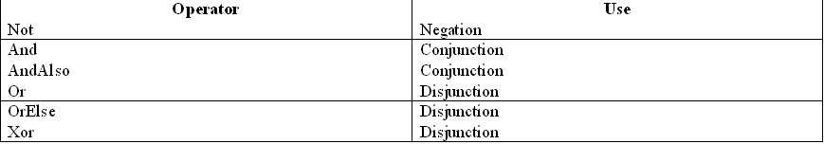
LOGICAL / BITWISE OPERATORS
The logical operators compare Boolean expressions and return a Boolean result.
In short, logical operators are expressions which return a true or false result over a conditional expression.
The table below summarizes them:

Slide 17
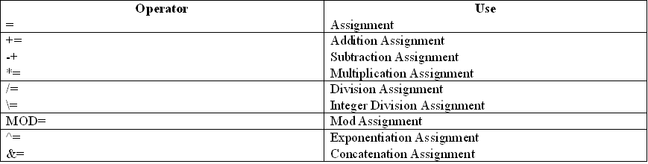
ASSIGNMENT OPERATOR

Slide 18
CONTROL STRUCTURE
Control structures control the flow of program's execution.
In a program, statements may be executed sequentially, selectively or iteratively.
Every programming language provides constructs to support sequence, selection or iteration.
So there are 3 types of programming constructs or structure in Vb.Net:
Sequential Constructs
Selection or Condition Constructs
Iterative or looping Constructs

Slide 19
SEQUENTIAL CONSTRUCT
The sequential construct means the statements are being executed sequentially. This represents the default flow of statements.
Statement 1
Statement 2
Statement 3

Slide 20
SELECTION OR CONDITION CONSTRUCT
The selection or decision construct means the execution of statement(s) depending upon the condition-test.
If a condition evaluates to True, a course-of-action (a set of statements) is followed otherwise another course-of-action is followed.
This construct is also called decision construct as it helps in decision making.

Slide 21
ITERATIVE OR LOOPING CONSTRUCTS
The iterative or repetitive constructs means repetition of a set-of-statements depending upon a condition-test.
A set-of-statements are repeated again and again till the condition or Boolean Expression evaluates to true.
The iteration constructs are also called as looping constructs.

Slide 22
SELECTION OR CONDITION CONSTRUCTS
VB provides two types of selection construct
If statement
Select Case statement
The If Statement : If statement of VB comes in various forms & are given below:
1) If..Then Statement
2) If..Then..Else Statement
3) If..Then..ElseIf Statement
4) Nested Ifs

Slide 23
IF..THEN STATEMENT
Definition : An If..Then statement tests a particular condition; if the condition evaluates to true, a course-of-action is followed otherwise it is ignored.
Syntax :
If (boolean expression) Then
statements
End If

Slide 24
IF..THEN STATEMENT
Example 1. :
If (Num>0) Then
MsgBox(“It is a positive number”)
End if
Example 2 :
If txtAge.Text>=18 Then
MsgBox(“You are eligible to vote”)
End if

